Slide 1


AMAZON DATA FINANCIAL ANALYSIS
By- Ayush Kumar Singh

Slide 2
Amazon, a global leader in e-commerce and technology, continuously pioneers convenience and innovation. Spanning sectors from retail to cloud computing, Amazon is transforming industries by prioritizing customer-centric solutions, thereby shaping the future of online commerce .
The significance of sales management has amplified in response to increasing competition and the need for more advanced distribution strategies aimed at reducing costs and boosting profits. In today's business landscape, sales management is paramount for ensuring the success and growth of business enterprises.
INTRODUCTION

Slide 3
1. Top 5 Categories by Gross Profit Margin:
1. Cosmetics:
- Dominates with the highest profit margin, indicating strong customer preference.
- Strong correlation observed between high sales and priority.
2. Household:
- Significantly profitable, especially the highest-priced item at $668.27.
- Offline sales outperform online, suggesting a preference for traditional markets.
3. Office Supplies:
- Consistent profitability but potential for improvement in sales.
- Delivery times may impact customer decisions.
Data Analysis Report

Slide 4
1. Top 4 Categories by Gross Profit Margin:
1. Cosmetics:
- Dominates with the highest profit margin, indicating strong customer preference.
- Strong correlation observed between high sales and priority.
2. Household:
- Significantly profitable, especially the highest-priced item at $668.27.
- Offline sales outperform online, suggesting a preference for traditional markets.
3. Office Supplies:
- Consistent profitability but potential for improvement in sales.
- Delivery times may impact customer decisions.
4. Baby Food and Cereal:
- Shows a steady profit margin, indicating a stable market for these products.
Data Analysis Report

Slide 5
2. Most Gross Profitable Product:
- Cosmetics: $173.87 profit, with average delivery time aligning with customer expectations.
3. Least 2 Non-Profitable Products:
1. Fruits: $2.41 profit
- Despite popularity, low profitability suggests a need for pricing adjustments.
2. Beverages: $15.66 profit
- Low profit may be due to lower customer priority. Reevaluating marketing or bundling options is recommended to increase sales.
Data Analysis Report

Slide 6
4. Profit Margin of Products (Top 5 listed):
- Cosmetics: 39.77% profit margin
- Household: 24.80% profit margin
- Office Supplies: 19.39% profit margin
- Baby Food: 37.55% profit margin
- Beverages: 33.00% profit margin
5. Most Expensive Item:
- Household: $668.27
- High-end products show potential for premium offerings. It is essential to analyze whether premium items align with the overall customer base.
Data Analysis Report

Slide 7
6. Cheapest Item:
- Fruits: $9.33
- While attracting orders, strategies to improve profitability should be considered, evaluating whether the lower margin is offset by higher sales volume.
7. Delivery and Priority Insights:
- Cosmetics delivery days: Average of 23 days align with high priority and popularity.
- Fruits delivery days: 26 days delivery time indicates a longer wait, affecting customer satisfaction.
8. Sales Insights:
- Household items: Offline dominates, suggesting a traditional market preference.
- Cosmetics: Customers prefer purchasing cosmetics products online, possibly due to convenience, variety, and reliability.
Data Analysis Report

Slide 8
9. Regional Analysis:
- Most Profitable Countries: Myanmar and Djibouti show high revenue, suggesting potential market growth. Understanding local preferences for targeted marketing is recommended.
- Least Profitable Countries: Kuwait, Kyrgyzstan, New Zealand, Slovakia, and Syria require analysis of cultural factors impacting sales and exploration of strategies to increase market share or considering market exit.
10. Year-wise Performance:
- Best Years: 2010, 2012, 2013, 2014 show high revenue and profit, with 2012 standing out with the highest number of orders, driven by personal care products.
- Worst Years: 2011, 2015, 2016, 2017 show lowest revenue and profit, with 2011 being particularly challenging.
11. Product Category Insights:
- Most Sold: Cosmetics. Understanding customer preferences to optimize marketing and considering bundling options is essential to boost sales in less popular categories.
- Least Sold: Meat. Analysis of customer aversion to meat products is necessary to evaluate the feasibility of maintaining this category.
Data Analysis Report

Slide 9
12. Customer Preferences:
- High Priority: Cosmetics, Baby Food, Cereal, and Household.
- Least Priority: Beverages and Fruits.
13. Online vs. Offline Preferences:
- Customers prefer to purchase household items offline, while cosmetic products are more popular online.
14. Monthly Trends:
- Most Orders: May, July, October, November show the highest order volumes, while January, March, June, August, September, December show lower order volumes.
Data Analysis Report

Slide 10
15. Regional Performance Insights:
- Asia: Highest revenue suggests prioritizing marketing strategies for cosmetics and clothes.
- Australia and Oceania: Beverage sales benefit from the hot climate, with beverages being the most sold item and cereal being the least sold due to regional climate preferences.
- Central America and Caribbean: Focus is needed on improving sales in the cosmetic category, with household items being the most sold and cosmetics being the least sold.
- Europe, Middle East, and North Africa: Opportunities in the oil and gas industry for office supplies should be explored, with cosmetics being the most sold and office supplies being the least sold.
- Sub-Saharan Africa: Adapting product offerings to suit hot climates and diversifying beyond low-margin fruits is recommended, with fruits being the most sold and meat being the least sold.
- North America: Personal care items are the most sold, and household items are the least sold due to regional climate variations.
Data Analysis Report

Slide 11
- Total Revenue: $137,348,768.31
- Total Number of Items Sold: 12
- Highest Sales Volume in Offline Mode:
- Product Category: Household
- Units Sold: 44,445
- Highest Sales Volume in Online Mode:
- Product Category: Cosmetics
- Units Sold: 41,969
- Lowest Sales Volume in Offline Mode:
- Product Category: Cereal
- Units Sold: 3,761
- Lowest Sales Volume in Online Mode:
- Product Category: Household
- Units Sold: 282
- Most Expensive Item:
- Product Category: Household
- Price: $668.27
- Least Expensive Item:
- Product Category: Fruits
- Price: $9.33
- Top 3 Bestselling Items on Amazon:
1. Cosmetics
2. Clothes
3. Beverages
- 3 Least Sold Items on Amazon:
1. Meat
2. Snacks
3. Vegetables
- Highest Gross Profit Margin Item:
- Product Category: Cosmetics
- Profit Margin: $173.87
- Lowest Gross Profit Margin Item:
- Product Category: Fruits
- Profit Margin: $2.41
Key Performance Indicators (KPIs) Summary:

Slide 12
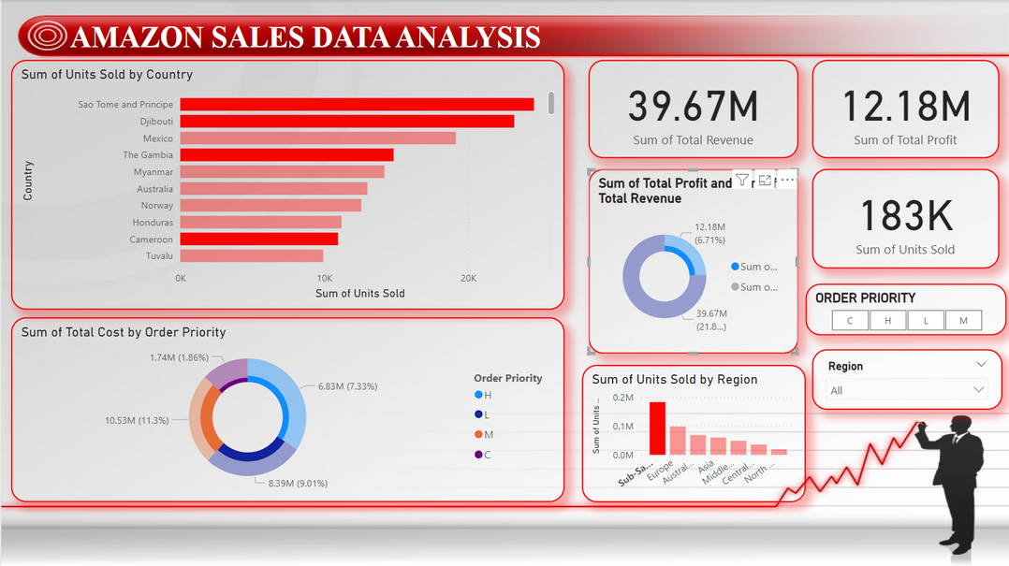
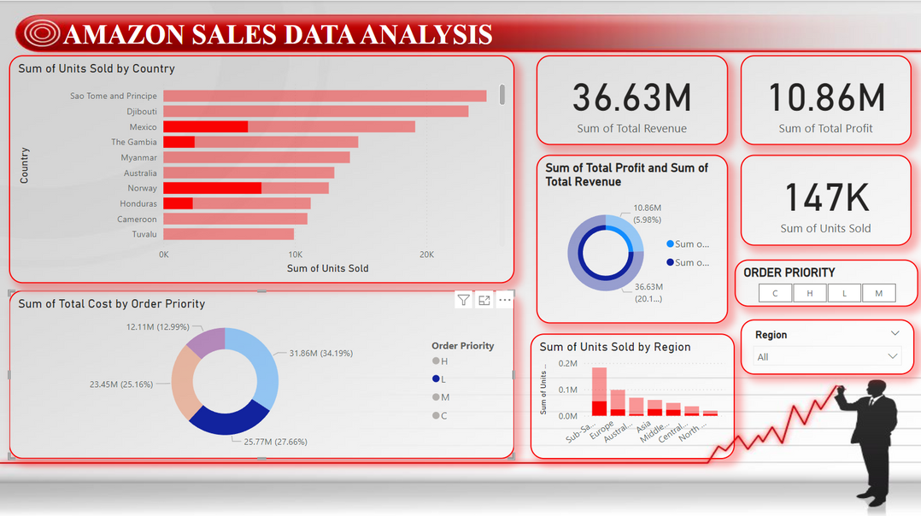
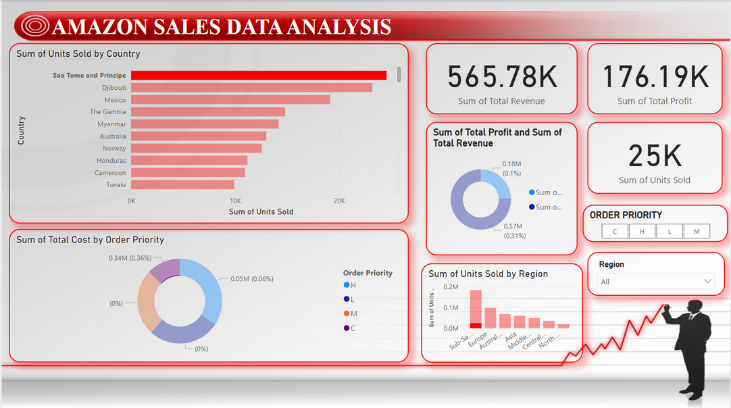
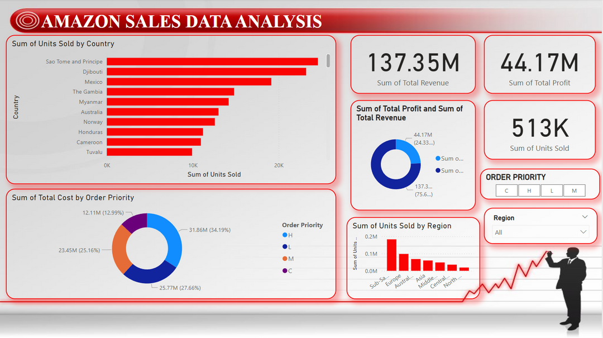
Insights

Slide 13
Thank
you!

